Slide 1

Document ID
Version: 1.0
Standard Operating Procedure for Data Analytics & MIS
Date of creation: 2024 April 04
Farzana
PARTICULARS
Scope
Responsibilities
Procedure
Flowchart

Slide 2
Purpose
The purpose of this SOP is to establish a systematic and standardized approach for the entire lifecycle of data analytics and MIS projects, ensuring consistency, reliability, and effectiveness in leveraging data for business insights.
Scope
This SOP governs the process of designing, developing, deploying, and maintaining data analytics and MIS solutions within the organization, aimed at facilitating data-driven decision-making and improving operational efficiency.

Slide 3
Responsibilities
Senior Management
Responsible for defining strategic goals, allocating resources, and approving project plans.
IT Infrastructure Team
Responsible for providing and managing the necessary hardware, software, and network infrastructure for data analytics..
Data Analytics Team
Responsible for executing the data analytics projects, including data gathering, integration, analysis, and visualization.
End-Users
Responsible for providing feedback, utilizing the analytics solutions, and making informed decisions based on the generated insights.
4

Slide 4
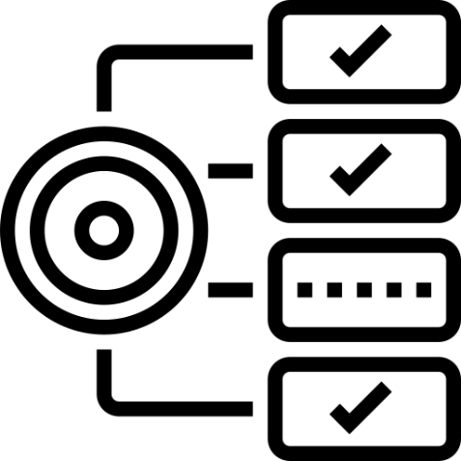

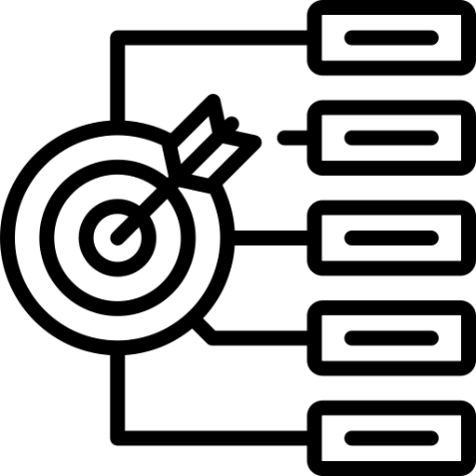

Requirements
Proficiency in data analysis tools and techniques.
Understanding of business goals and KPIs
Strong communication and collaboration skills.
Knowledge of data governance and security principles.

Slide 5
Procedure for Data Analytics & MIS
Define Objectives and Requirement
Identify key business goals and KPIs through stakeholder interviews and workshops.
Determine dashboard purpose (monitoring, analytics, operations etc) and end-user persona (executive, manager, analyst).
Define specific metrics and dimensions to track based on business needs.
Specify minimum viable functionality and features (filters, drill-downs, derived metrics etc).
Document technical specifications - data sources, update frequency, software platforms.
Create user stories to capture detailed requirements from multiple perspectives.
Obtain sign-off on requirements from all client stakeholders.
2. Data Gathering and Integration
Catalogue all potential data sources (CRM, ERP, databases, APIs, spreadsheets etc).
Assess data quality - accuracy, completeness, consistency. Cleanse and transform as needed.
Model entity relationships to link datasets via common fields.
Build ETL processes to automate data integration from diverse sources.
Standardize date formats, naming conventions, schema etc across sources.
Validate integrated data, check for errors, duplicates, missing values.
Optimize data model - indexes, aggregation, compression - for fast query performance.
Store integrated data in a dedicated database or data warehouse.

Slide 6
3. Design and Develop Dashboard
Evaluate different dashboarding platforms based on feature set, scalability, pricing, usability.
Create wireframes and mockups to capture initial design concepts.
Standardize layouts, color schemes, font usage per client brand guidelines.
Build charts, tables, KPI visualizations to present data insights effectively.
Implement custom interactive functionality via scripts, plugins, APIs.
Create dynamic filters, actions, parameters to customize view for each user.
Implement alerting, notifications based on defined trigger conditions.
Configure autosave, versioning, git integration for iterative development.
Perform extensive unit testing throughout development process.
4. Testing and Validation
Verify calculation logic, data accuracy across all metrics and visuals.
Check for errors or unexpected behaviors in different use cases and with different parameter inputs.
Review dashboard security, access controls, and permissions functionality.
Load test dashboard with simulated production-level data volumes. Tuning as needed.
Solicit feedback from all stakeholder groups through demos and review sessions.
Address bugs, issues, change requests gathered during reviews and testing.
Iterate on information design, layouts, and styles based on feedback.
Gain official approval and sign-off for dashboard release from client sponsors.

Slide 7
5. Deployment and Access Control
Provision and configure server infrastructure for dashboard application.
Implement robust security protocols including SSL, VPN, SSH, Role-based Access Control lists.
Create user roles and permission groups aligned to org structure.
Develop onboarding guides and usage instructions for end-users.
Automate dashboard data refreshes and job scheduling.
Set up monitoring for key performance metrics - uptime, load, errors.
Establish data recovery and backup procedures.
Roll out communication plan to introduce dashboard to end-users.
6. Maintenance and Improvements
Monitor platform reliability and data accuracy - address any issues.
Develop a product roadmap based on new user requests and business needs.
Continually refine and optimize performance based on usage data and feedback.
Implement new features and enhancements in iterative development cycles.
Maintain comprehensive documentation and technical specifications.
Evaluate new dashboarding technology for possible upgrade.
Audit data sources regularly for changes that may impact dashboard.
Budget time and resources for ongoing dashboard operations and support.
Gather user feedback to guide improvement priorities.

Slide 8
General Instructions
Adhere to established project timelines and milestones.
Ensure alignment of analytics solutions with business objectives.
Maintain data integrity and confidentiality throughout the process.
Regularly communicate progress and updates to stakeholders.
Continuously seek opportunities for process improvement and innovation.
8

Slide 9
General Challenges
Ensuring data quality and consistency across diverse sources.
Addressing scalability and performance issues with increasing data volumes.
Balancing the need for data accessibility with security and privacy concerns.
Managing stakeholder expectations and priorities effectively.
Keeping pace with technological advancements in data analytics tools and platforms
8

Slide 10
Process Implementation Checklist
Do’s | Don’ts
Do conduct thorough requirements gathering and analysis. | Don't overlook the importance of data quality assurance and validation
Do prioritize data governance and security measures. | Don't neglect end-user training and support.
Do engage stakeholders throughout the project lifecycle | Don't neglect end-user training and support.
Do engage stakeholders throughout the project lifecycle | Don't ignore feedback from end-users and stakeholders during the development and deployment phases.
8

Slide 11
Inputs

Slide 12
Link to Sample

Slide 13
Revision History
Appendix
Archives

Slide 14
THANKYOU

